Slide 1
Occupational Specialist Component Content: Digital Production, Design and Development
The T Level T Level Technical Qualification in Digital: Digital Production, Design and Development includes a single Occupational Specialist Component. Therefore, there is a single synoptic assessment for the Occupational Specialist Component, which is an extended ‘design, development and implementation’ project. The synoptic element of the project is important in order to ensure that students are able to demonstrate threshold competence: this is the principal reason why the Occupational Specialism is assessed via a single extended project assessment to ensure that students are able to evidence all the skills required by the Performance Outcomes.
The T Level Technical Qualification in Digital: Digital Production, Design and Development Occupational Specialist Component consists of several activities grouped into four substantive tasks.
Each task will be completed during a window set by Pearson during which you will schedule supervised assessment sessions. In some cases, tasks will also involve opportunities for unsupervised activities where the requirements of the skills being assessed make this necessary.

Slide 2
The unit outcomes
1.6 Understand how to identify and be able to address personal training needs that can boost job performance during the software development process.
Considerations to ensure the software developer is able to complete the required solution:
identify what further knowledge is needed.
identify what new skills are needed.
determine if software developer has the ability needed to complete the required solution.
Use different methods to address personal training needs required to enable completion of project:
undertake coaching from a professional or peer.
learn new skills on the job.
carry out self-study.
use online professional forums.
sign up to internet workshops for additional training.

Slide 3
Learning Objectives
Aims:
To introduce evaluation of personal development plans
Objectives:
To be able to define how personal development plans are reviewed both from an employer’s and personal perspective.
Notes:
Evaluating CPD

Slide 4
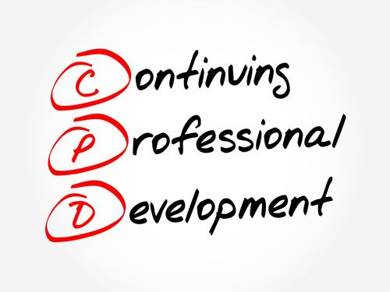
Continuing Professional Development
Professional development is about CHANGE.
The purpose of professional development is to improve learner outcomes by changing instructional behavior to achieve a pre-determined goal(s).
While learning about such innovations may be relatively easy, applying them in a consistent and insightful manner is another matter
As Guskey (1986) notes, practitioners appear to be most motivated to change as they observe learner success and satisfaction and this cannot occur immediately.

Slide 5
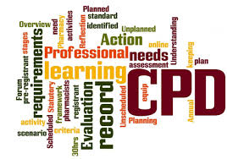
Continuing Professional Development
Furthermore, for professional development, like learning, to be successful, it “must be adapted to the complex and dynamic characteristics of specific contexts” (Guskey, 1995).
This change process takes time.
Therefore, it is unreasonable to expect that individual professional development activities will immediately result in altered long-term instructional behaviour, improved learner performance, or changed organizational structures and practices.
The role of evaluation, then, is not only to provide information on the impact of professional development, but also to provide data for refining and adjusting professional development activities to ensure that services can be improved on an ongoing basis.

Slide 6
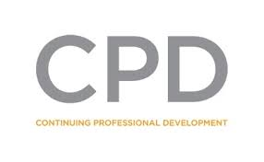
Employers - Evaluating CPD
It is in the employer's interest to evaluate their investment in service delivery, stakeholders and the organisation as well as individual workers.
Often evaluation only concentrates on the training course and sometimes on the outcomes for the individual learner.
Although these outcomes are important, they only indicate whether a learning opportunity has achieved its immediate objectives and not whether it has improved practice or service delivery outcomes.
Therefore, it helps to measure desired outcomes such as:
changes in services and delivery
improvements in recruitment and retention
improvements in performance
increased staff motivation
reduction in stress levels.

Slide 7
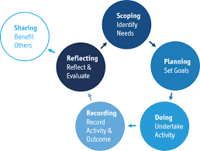
Employers - Evaluating CPD
The employer’s approach to evaluation will help to identify what needs to be achieved from developing their workers and the most cost-effective way of doing it.
The employer will need to know what skills and qualifications their workers need to provide services that meet the requirements of people who use their services and the learning opportunities which meet their needs and employee's career aspirations.
The process starts with:
identifying the purpose of learning and training
identifying the expected benefits for the user of the service and the organisation
clarifying what business objectives or needs it will meet
developing criteria to demonstrate these have been achieved.

Slide 8
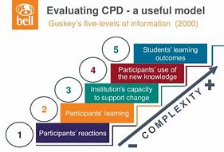
Employers - Evaluating CPD
Effective professional development evaluations require the collection and analysis of the five critical levels of information shown in Figure 1 (Guskey, 2000a).
With each succeeding level, the process of gathering evaluation information gets a bit more complex as each level builds on those that come before, success at one level is usually necessary for success at higher levels.
The five level of Guskey’s professional development evaluation are:
Participant's reaction
Participants' Learning
Organization Support & Change
Participants' Use of New Knowledge and Skills
Student Learning Outcomes
Notes:
https://www.google.co.uk/search?q=how+research+based+best+practices+are+used+for+evaluating+the+pd+program&sa=X&ved=2ahUKEwjLpuO4zOrpAhW0WRUIHcVzCUkQ1QIoA3oECBsQBA&biw=1235&bih=824&safe=active&ssui=on

Slide 9
Activity
In groups, discuss what will make good personal development goals for work and then share them with your peer groups.
Some areas you might want to consider are:
Improve your time management.
Develop emotional intelligence.
Cultivate resilience.
Listen actively.
Develop a growth mindset.
Develop a reading habit.
Learn new things.
Improve your public speaking skills.

Slide 10


Personal Development Plan
It could be argued that an employer’s PDP could be the same for all employees.
However, there is no such thing as a one-size-fits-all approach to development.
We all have our own strengths and weaknesses, and our own needs when it comes to what will help us realise our potential.
That’s where the Personal Development Plan, or PDP, comes in!
It’s also known as the IDP (Individual Development Plan), and it acts as a roadmap for how an individual should drive their professional growth.
So an employee should be able to look at their PDP at any time to find out exactly what work they should be doing to develop their knowledge and skills.
Because it’s tailored to them, a good PDP acts like a jigsaw piece, filling in any gaps in an employee’s skillset and making them into a perfect, beautiful picture!

Slide 11
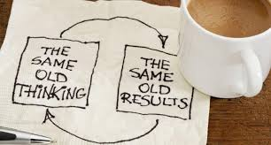
Personal - Evaluating your Success
The learning process is a cyclical process in which you need to identify your development goal, initiate the action(s) that you need to reach your goal and then periodically you have to evaluate your progress.
Taking time to evaluate and reflect your progress is essential to enable you to make necessary changes to your plan.
When evaluating your progress you need to ask yourself:
What have I learnt?
What more do I need to do to achieve my goals?
Is my progress too slow or ahead of schedule?
Do I need any assistance to achieve my goal?
What’s hindering my progress?
Do I need to change my plan?
What additional benefits am I gaining from the process?

Slide 12
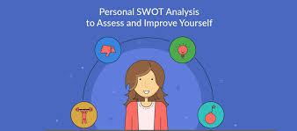
Evaluating Your Personal Development
It is worth taking time to review your activities against your plans on a regular basis, probably every quarter or so.
Less often, and you may find that you are not placing a high enough priority on your development activities and letting progress slip.
More often, and you are likely to find that you have not made enough progress, or that you are tempted to put the review off, because the last one was so recent.
Regular review will ensure that you keep tabs on your activity and are not tempted to make personal development a lower priority.
It is easy to forget about personal development, especially if you have just started a new job or course of study.
But a regular review of your development plan keeps the process on track.

Slide 13
A possible review process
Set aside time for your review. It is no good trying to reflect meaningfully in just five minutes. Make sure you are in no rush, and also that your environment is conducive to quiet reflection.
Find your original plan, with your goals and planned activities. You need to know what you said you were going to do.
For each planned activity, assess how far what you have done by way of activity was in line with your plan. You need to be honest with yourself:
How much did you do?
Was it as much as you were expecting to achieve?
Did you do something different, but more effective?
Consider how successful you feel your development has been in getting you to your goals.
Have you made progress towards your goals?
Have you identified more activities that will need doing that might slow down your progress?
Are your goals (and their timing) still realistic?
Decide what you need to do next.
Is it more of the same, or something different?
Do you need to take more time, or find some external support, perhaps?
Revise your plan to set out your new activities.
Notes:
It is helpful to document your thinking during the review process. This means you can look back next time and remember why you changed your goals or activities. It also helps to articulate the reasons behind the decisions, and make sure that they are not just ‘I couldn’t really be bothered’.

Slide 14

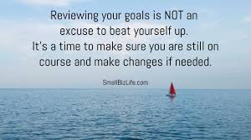
Reviewing Your Goals
Every year or so, it is also likely to be helpful to review your personal development goals.
As with the review of your planned activity, it is important to set time aside for this process.
Again, it is also helpful to document it, because this forces you to articulate your reasoning.
Ask yourself:
Are these goals really what I want to achieve more than anything else?
Do they inspire me to take action?
If the answer to either of those is ‘no’, then you probably have the wrong goals.

Slide 15
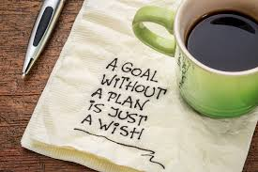
Self-motivation, personal goals and achievement
There is a strong correlation between self-motivation, personal goals and achievement.
In order to get properly motivated, and indeed to achieve, it helps to spend some time thinking about your personal goals and what you want to achieve in your life.
We all have an inbuilt desire to achieve.
What we want to achieve, however, is personal to us and may change through life. At school, for example, you may want to achieve good grades, then later you may want to pass your driving test or get a job.
It is important to set yourself clear goals if you wish to achieve your ambitions.

Slide 16
Making Your Goals SMART
It can be useful to make your goals and sub-goals fit the SMART criteria
S | Specific Make each goal specific, so you know exactly what it is. Take some time to clearly define your goals and sub-goals, the more detail about what your goals are and how you intend to achieve them the better.
M | Measurable Make each goal measurable so you know how you are progressing. You need to be able to see how you are progressing to reaching your goals. What metrics can you use to measure your progress?
A | Attainable Don’t set impossible goals, make sure each goal and sub-goal is attainable. The larger the goal the more impossible it may seem but if you split it down into simple sub-goals then you will find each step is more attainable.
R | Relevant Make your goals relevant. Ensure your sub-goals are relevant to your life goals. Try not to set goals that don't ultimately help you to achieve your overall life goals.
T | Timed Set time-limits or deadlines for each goal and sub-goal. If you can set and stick to realistic deadlines, then you'll avoid too much distraction or procrastination and keep yourself motivated.

Slide 17
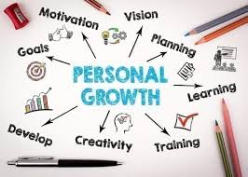
Changing the picture
If you are struggling to identify your real goals, try doing something different.
For example, take yourself away for the weekend and go for a long walk. Walk up a hill and sit and look at the view.
Think about what matters to you. What do you really want out of life?
The advantage of going somewhere outdoors is that the landscape has been there a long time, and it has a way of making things look simpler. But you can try doing almost anything that takes you away from your usual environment and gives you time to think.
It is fine if the answer is ‘I don’t really have any goals right now, because I’m pretty happy with my life’. In that case, give yourself a break and don’t worry too much about personal development for a bit. But do come back to it in a few months, a year at most, and make sure that this is still the case.
Notes:
The answer, however, is more likely to be ‘yes, but…’
In other words, yes, that is still more or less what you want, but you have refined your thinking consciously or unconsciously. In that case, tweak your goal until you are feeling more inspired, and it really is what you want to achieve more than anything else.
Once you have your revised goals, you can then go through the process of deciding what activities you need to develop your skills.

Slide 18

Reviewing your Life Goals
As with anything in life, just setting goals is not enough.
You have to review your goals regularly, perhaps every few months, and certainly every year, to make sure that:
The goals are still relevant to what you want to achieve; and
You are on track to achieve them.
If not, you need to revise them, in line with your current situation.
Your goals need to motivate you and excite you
It doesn’t matter if you haven’t had as much time as you would have liked to devote to learning to play the piano; it does matter if you haven’t done anything towards it because you’re really not that bothered about it.

Slide 19
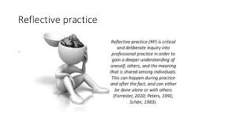
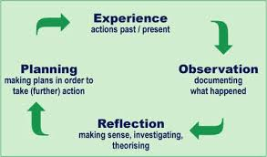
Moving Towards Reflective Practice
In time, regular review and reflection on what you have achieved should become a habit.
You may find it helpful to read our page on Reflective Practice to understand more about this.
The process outlined on this page of reviewing your plans and goals on a regular basis is a step in that direction.
It ensures that you set aside time for reflection, and hopefully, that you start to document your thinking and progress on personal development.
Remember, though, that there is no rush.
There is a reason why personal development is sometimes called ‘lifelong learning’…

Slide 20
Activity
Identifying areas for improvement in your personal development plan
Reviewing progress on a personal development plan will automatically help you identify different directions that you can go within your current role.
The specific areas you should look at are:
Progressed against set targets.
Key communication skills needed within your present role and identify how you can improve on these
Technical skills that you need to develop
Other areas that you can identify to be improve as part of a personal development plan
Set new targets and look at additional training opportunities which will help you get the best out of your personal development within the workplace.

